Slide 1
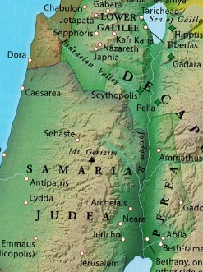
John 3.22-36
Map from Rasmussen,
Zondervan Atlas of the Bible
John the Baptist
Jesus
Jerusalem

Slide 2
John 3.22-24 [NET]:
After this, Jesus and his disciples came into Judean territory, and there he spent time with them and was baptizing. John was also baptizing at Aenon near Salim, because water was plentiful there, and people were coming to him and being baptized. (For John had not yet been thrown into prison.)

Slide 3
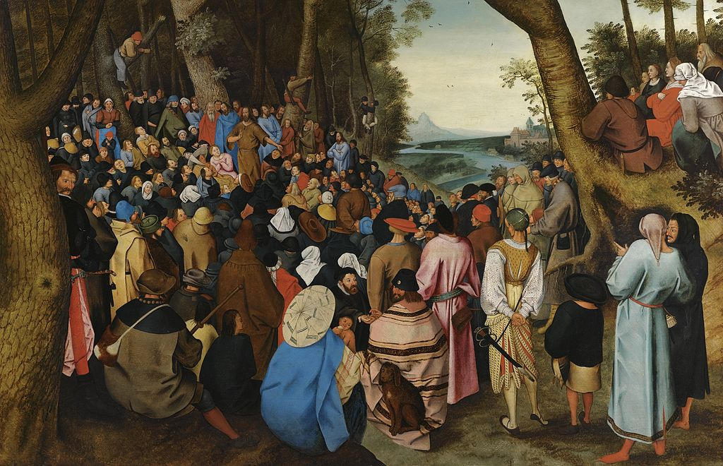
Pieter Brueghel the Younger
John 3.25-26: Now a dispute came about between some of John's disciples and a certain Jew concerning ceremonial washing. So they came to John and said to him, “Rabbi, the one who was with you on the other side of the Jordan River, about whom you testified– see, he is baptizing, and everyone is flocking to him!”

Slide 4
Pieter Brueghel the Younger
John 3.27-28: John replied, “No one can receive anything unless it has been given to him from heaven. You yourselves can testify that I said, ‘I am not the Christ,’ but rather, ‘I have been sent before him.’”

Slide 5
Pieter Brueghel the Younger
John 3.29-30: “The one who has the bride is the bridegroom. The friend of the bridegroom, who stands by and listens for him, rejoices greatly when he hears the bridegroom's voice. This then is my joy, and it is complete. He must become more important while I become less important.”

Slide 6
John 3.31-34: The one who comes
from above is superior to all. The
one who is from the earth belongs
to the earth and speaks about
earthly things. The one who comes
from heaven is superior to all. He
testifies about what he has seen
and heard, but no one accepts his
testimony. The one who has
accepted his testimony has
confirmed clearly that God is truthful. For the one whom God has sent speaks the words of God, for he does not give the Spirit sparingly.

Slide 7
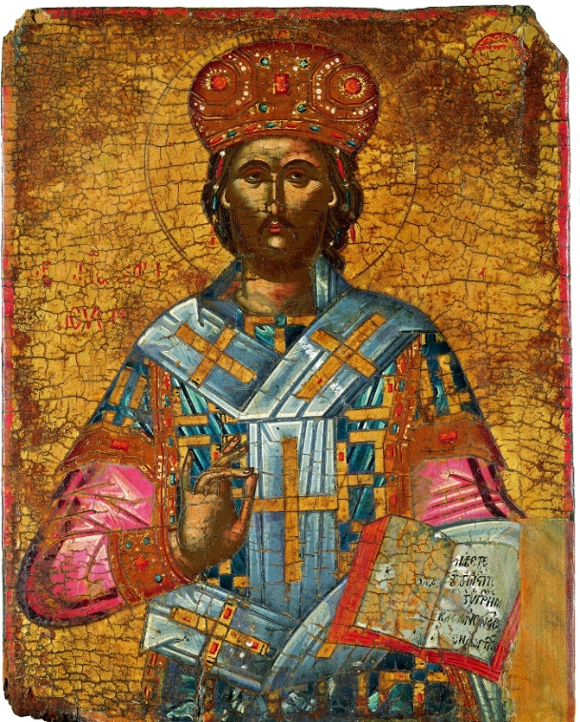
John 3.35-36: The Father loves the Son and has placed all things under his authority. The one who believes in the Son has eternal life. The one who rejects the Son will not see life, but God's wrath remains on him.
“Christ the King of Kings”
Art in the Christian Tradition
Vanderbilt Divinity Library

Slide 9
Francesco di Andrea di Marco
Crucifixion
Metmuseum.org

